Slide 2
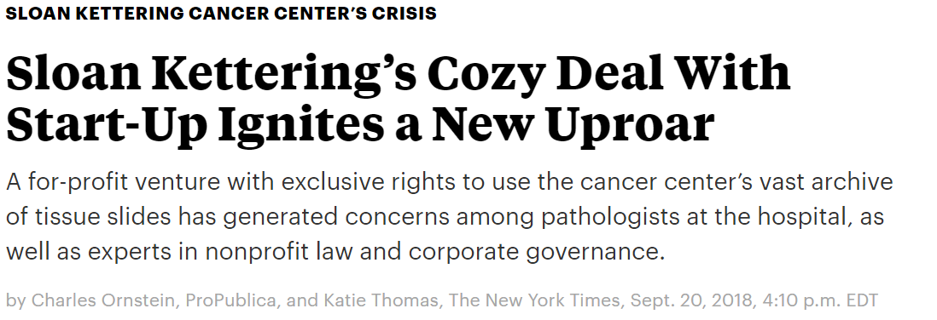
The Bad

Slide 3
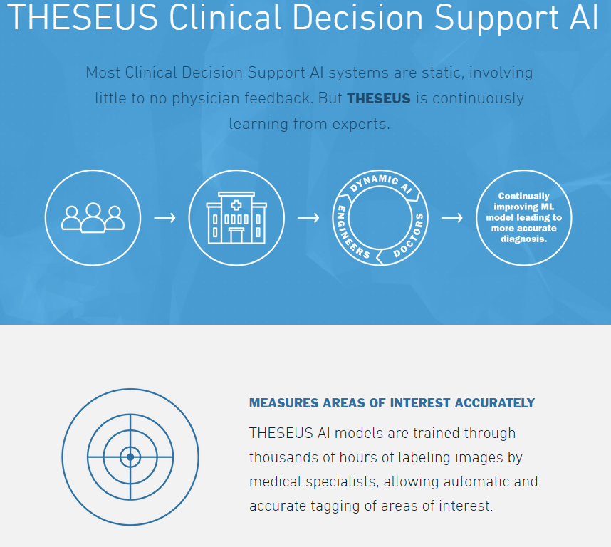
The Good

Slide 4
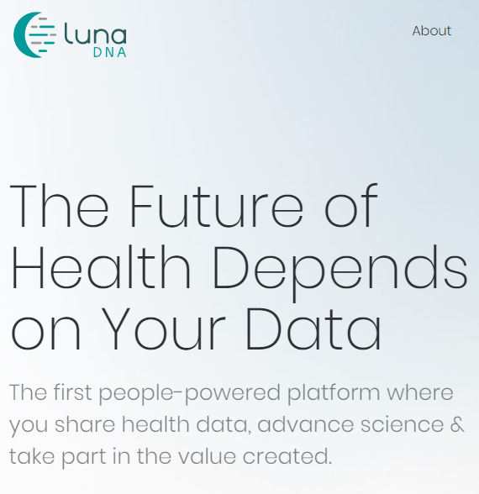
The Novel
LunaDNA is the first health and DNA discovery platform owned by its community of data contributors. When you share your health information to our secure platform, you become a true co-owner of the organization and share in the value created from medical breakthroughs.

Slide 5
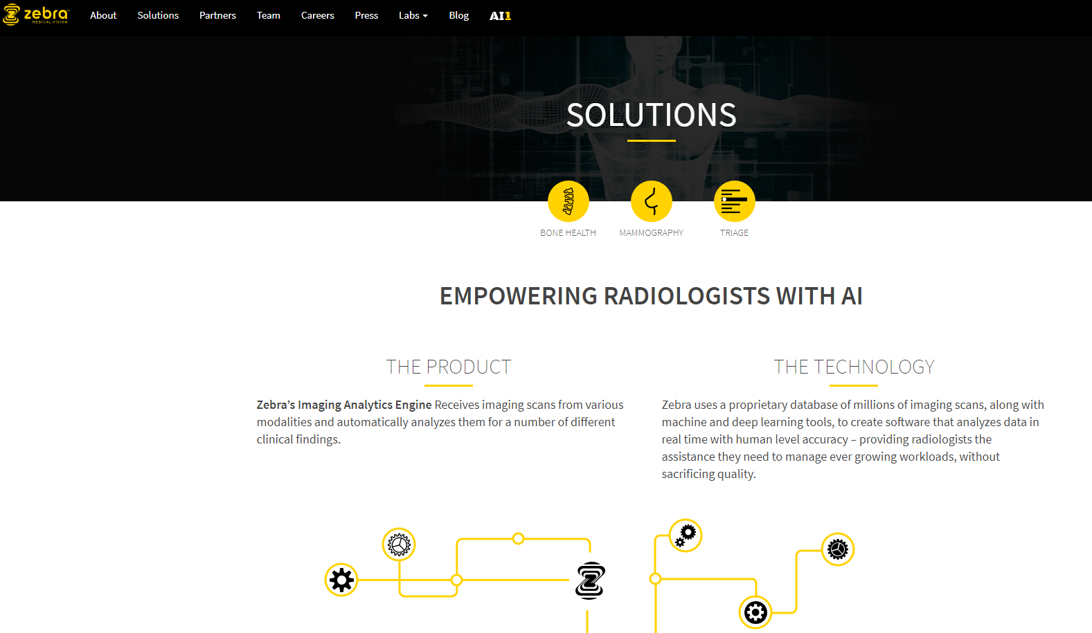
The successful

Slide 6
Chaotic landscape in data deals at universities
Key Learnings to date:
Ad hoc, painful data licensing activity is happening now
Top-down and bottom-up pressure from administration and faculty
Home-brew efforts
Lost opportunities
Hierarchy of needs/liabilities
Privacy
Conflicts of interest
How to value data? Derived products?

Slide 7
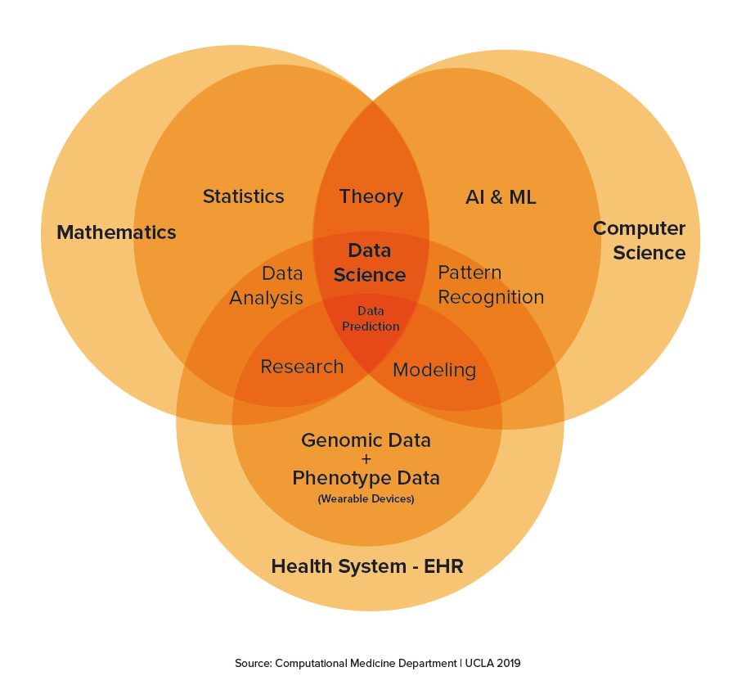
Solutions
Cloud sand box
Computational Medicine
Internal vetting process for data release

Slide 8
