Slide 1
UCLA Health Data Day
Our Analytics Footprint & Exciting New Capabilities
Michael A. Pfeffer, M.D., FACP
Assistant Vice Chancellor & Chief Information Officer
UCLA Health Sciences
Associate Clinical Professor of Medicine
David Geffen School of Medicine at UCLA

Slide 2









Slide 3
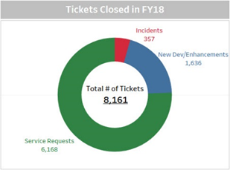
Current Analytics Footprint at UCLA Health
Self-Service
53 Centers of Excellence
632 Tableau Dashboards
573 SAP Web Intelligence Reports/Dashboards
Predictive Models
17 Available Epic Models
  4 Enabled
  5 Under Evaluation
CareConnect Clarity Reports
2,530 Clarity Reports
4,505 Total Monthly Reports
CareConnect Hyperspace Reports
OHIA Projects & Requests
685 Reporting Workbench Reports
813 Radar Dashboards
52 Projects Completed
8,161 Tickets Closed

Slide 4
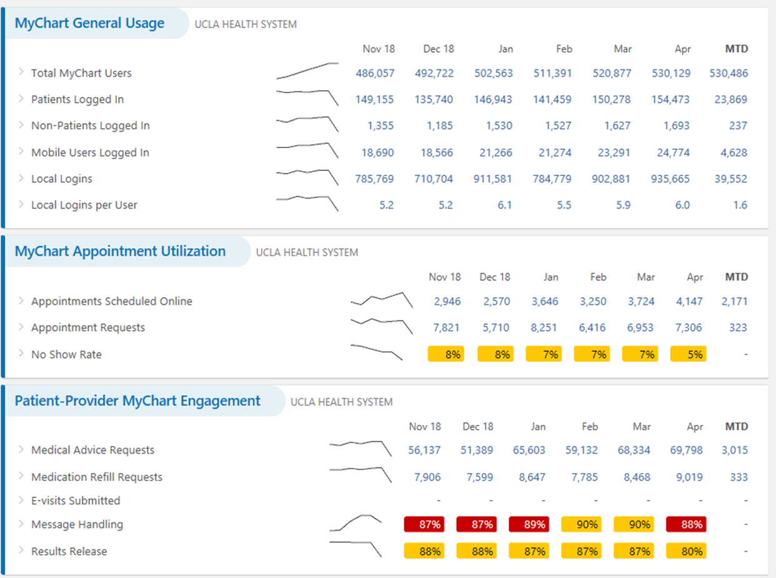
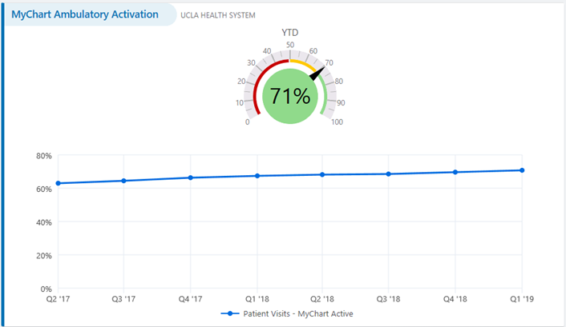
Example: MyUCLAHealth Utilization Dashboard
CareConnect Radar Dashboard
~300 leadership and analyst users

Slide 5
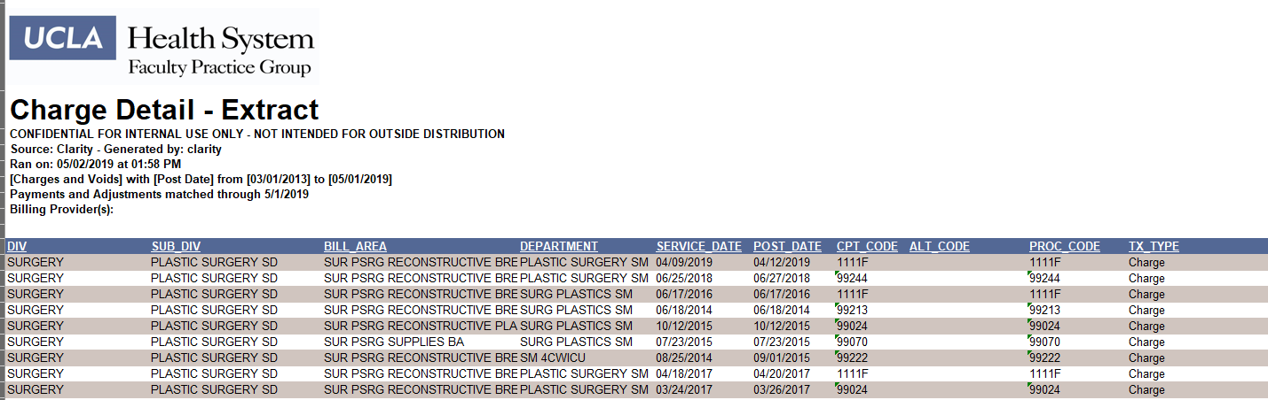
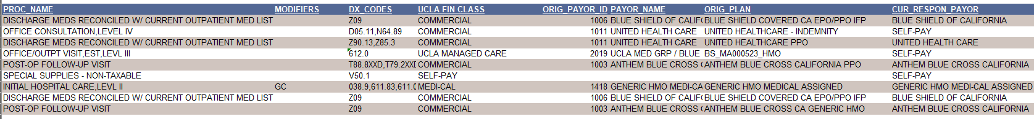
Example: Professional Billing Charge Detail Report
CareConnect Clarity Report
Tracks charges posted after outpatient visits
Used by ~500 providers

Slide 6
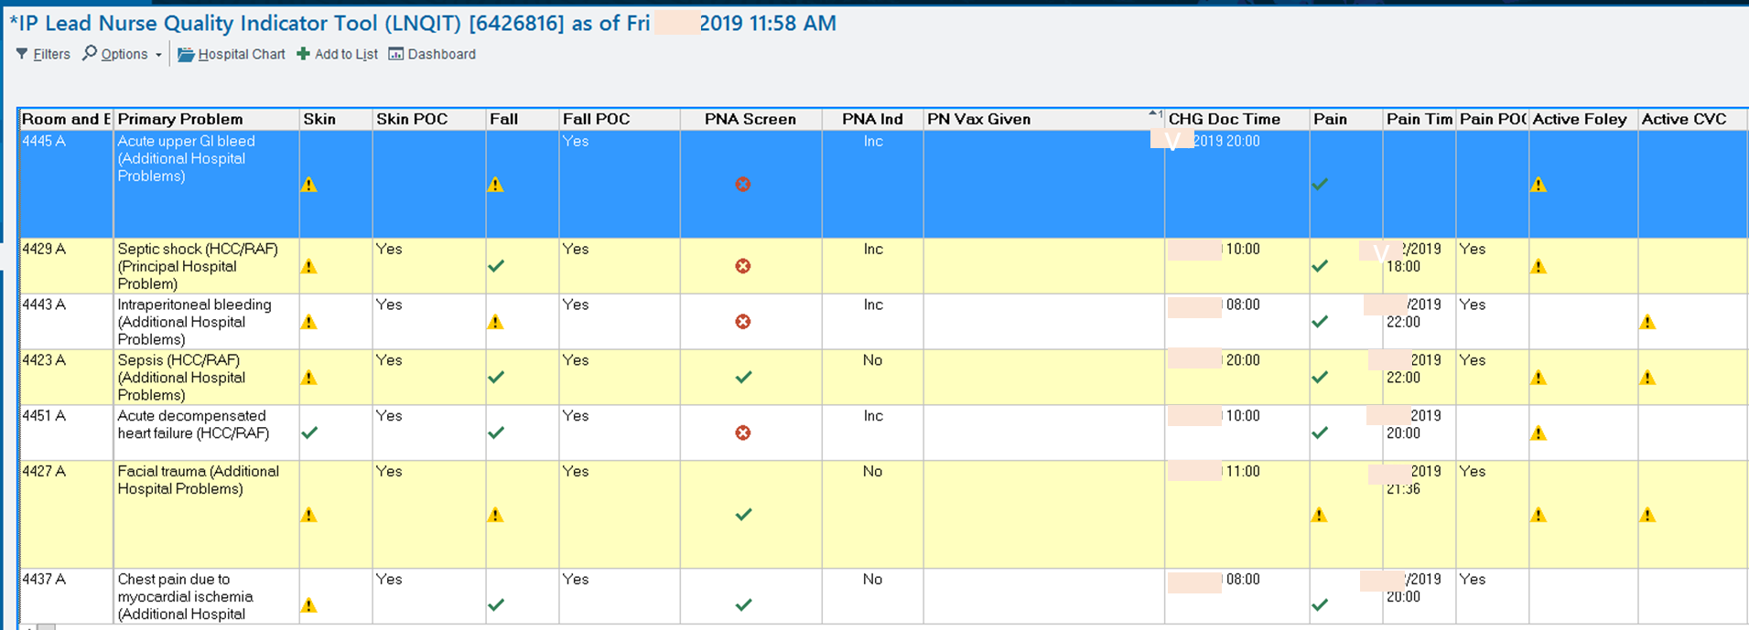
Example: Inpatient Lead Nurse Quality Indicator Tool
CareConnect Reporting Workbench Report
Used by lead nurses to monitor the documentation and invasive devices

Slide 7
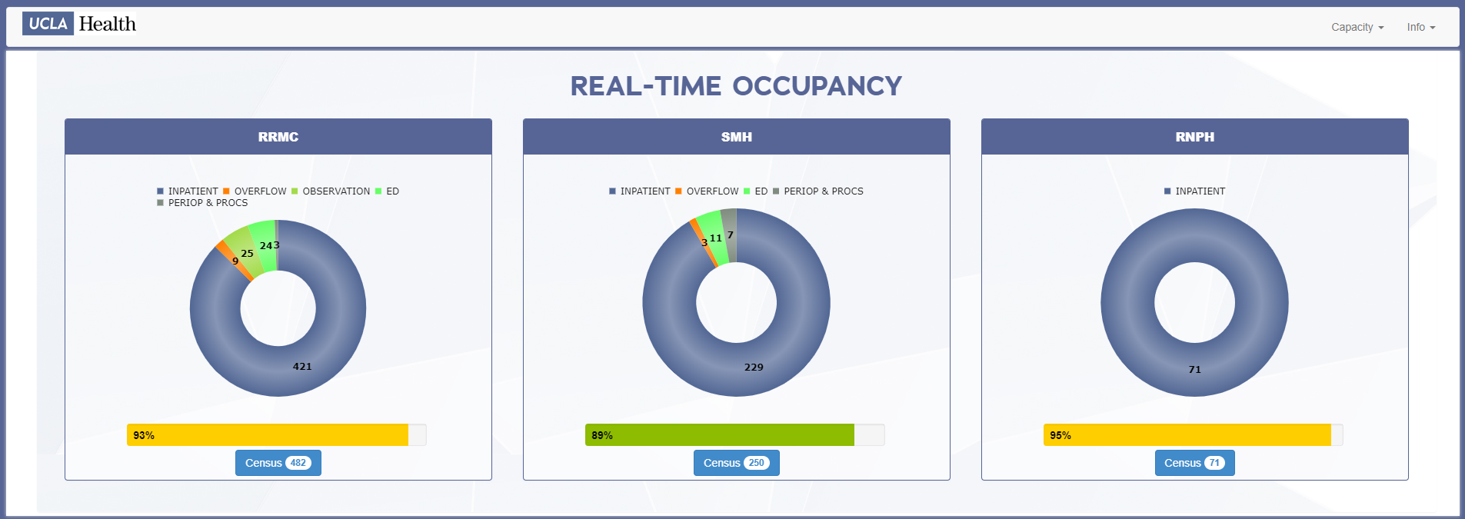
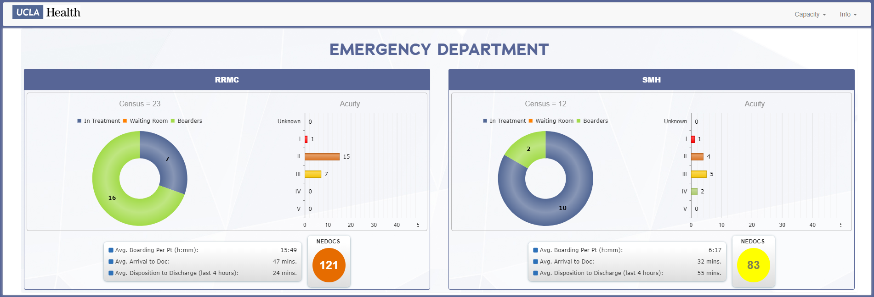
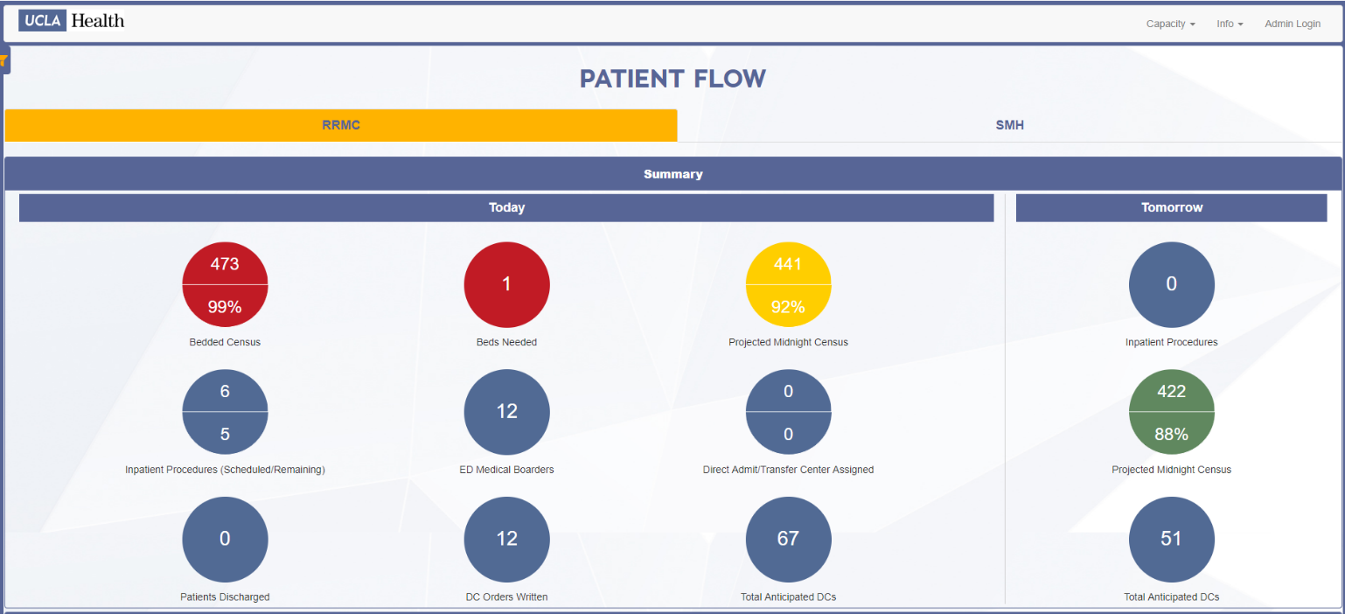
Example: Operations Real-Time Dashboards
OHIA Project in Collaboration with Performance Excellence and Operations
https://dashboard.mednet.ucla.edu/

Slide 8
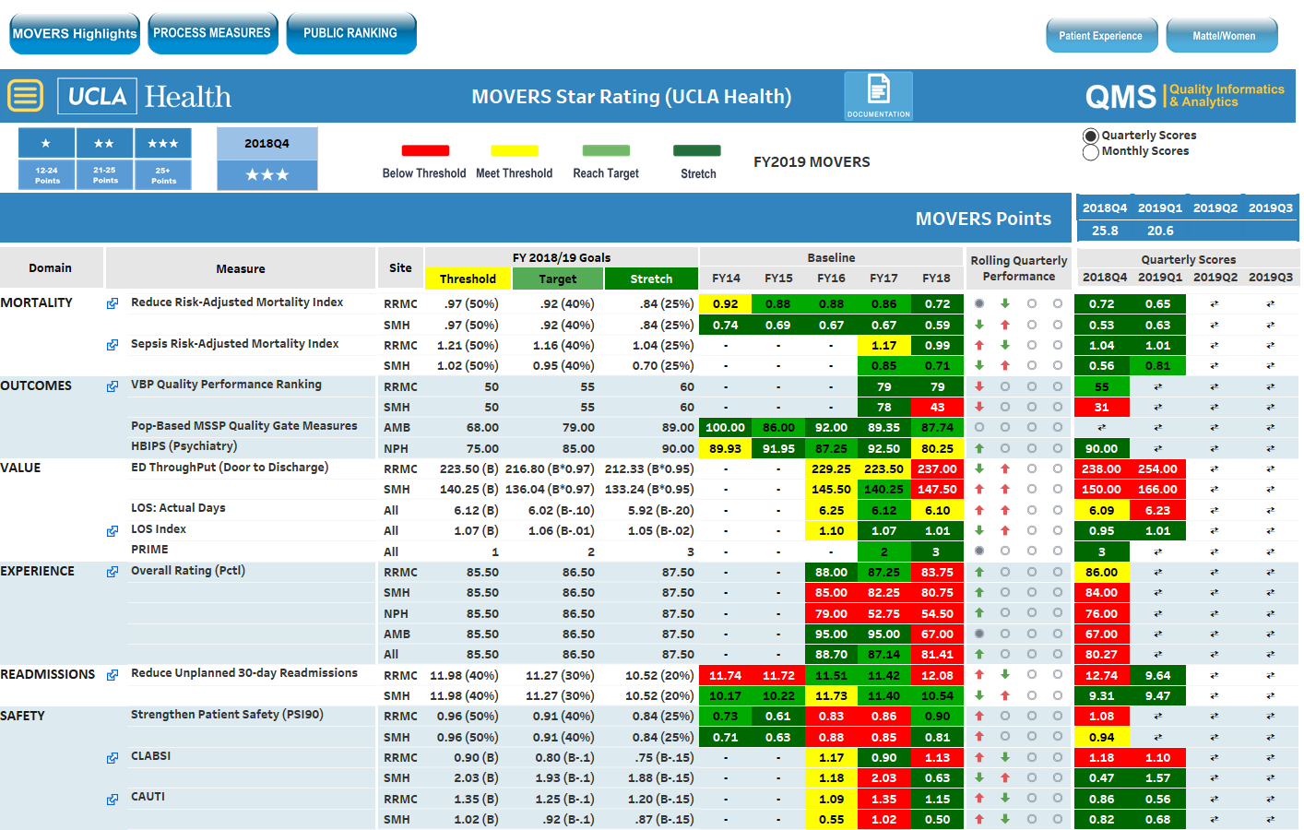
Example: MOVERS Quality Dashboard
Self-Service Quality Center of Excellent Tableau Dashboard

Slide 9
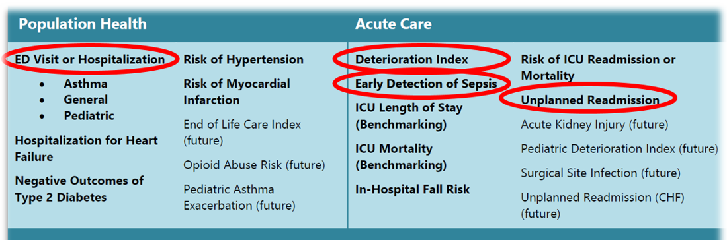
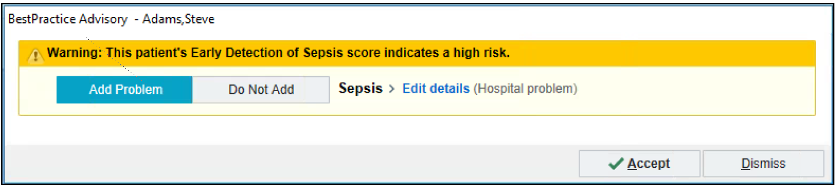
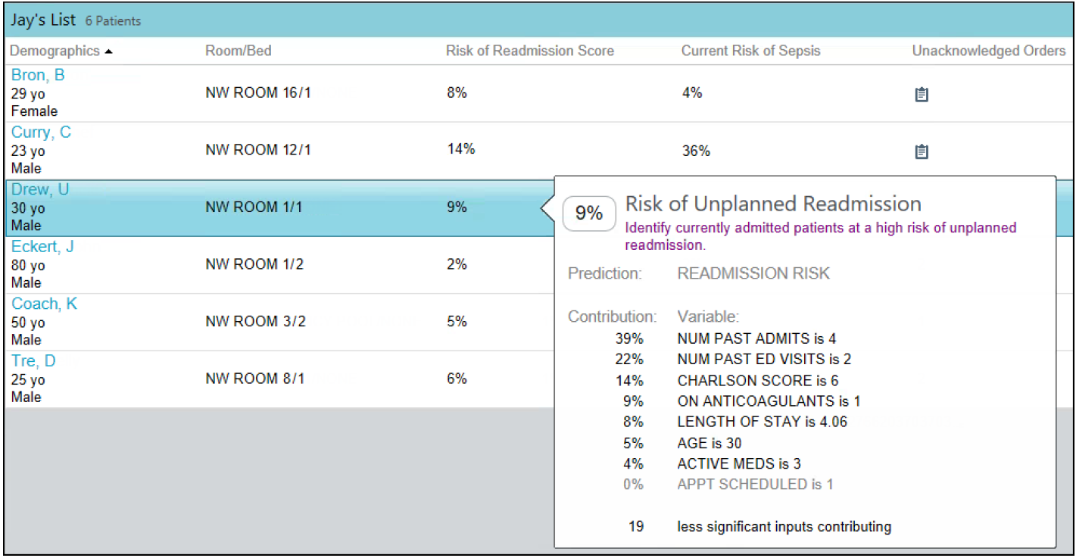
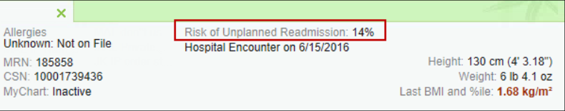
Example: Predictive Models
Each model in the library is accompanied by workflow and user interface elements that can prompt users to take clear next steps

Slide 10
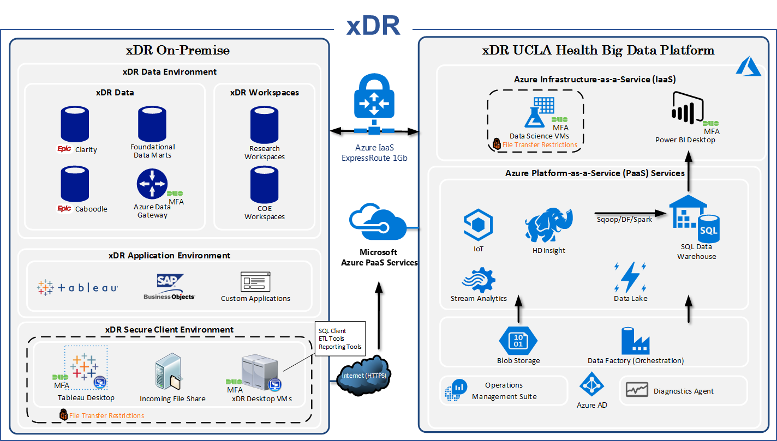
Support for Research and Non-Research Use Cases
Health Data Request
CTSI Informatics Program
Cohort Discovery
Honest Broker
Data Provisioning
Data Release
OHIA
Enterprise-wide
Operational
Financial
Quality
Research Use Cases
Non-Research Use Cases
Collibra Data Governance Layer
Delivery of Data/Analytics

Slide 11
New Capabilities

Slide 12
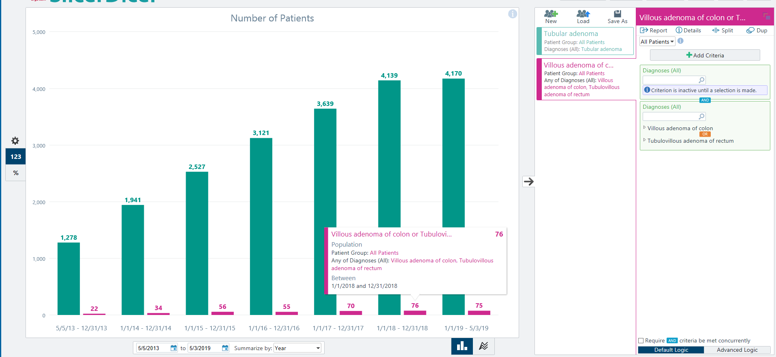
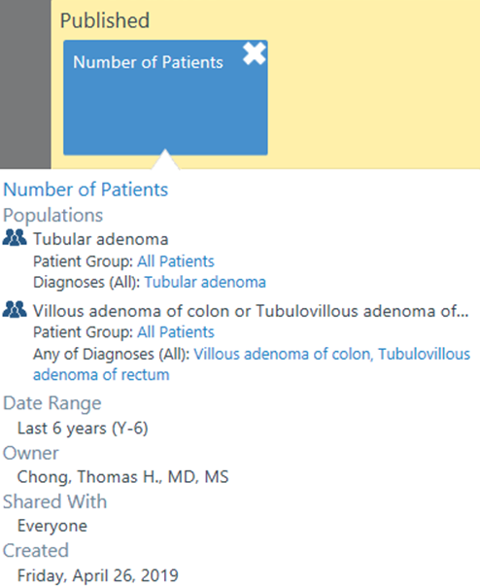
CareConnect’s SlicerDicer
SlicerDicer is now in pilot approximately 60
Feedback from the pilot users will inform the roll-out plan to additional users
Will be part of CareConnect v4 Upgrade
This session compares the number of patients with a tubular adenoma diagnoses to the number of patients with a villous adenoma of colon or tubulovillous adenoma of rectum over the past 6 years

Slide 13
Waveform Data Discovery Solution

Slide 14






UC Health Data Warehouse (UCHDW) Platform
UC Health Data Analytics Platform
UC Health Quality Measures Engine (QME)
External Data Feeds:
Claims
Vizient (UHC)
Press Ganey
OSHPD
Census
Support Prioritized Partnerships:
Population Health
Pharmacy
Cancer Consortium
Supply Chain Analytics
Health Data Warehouse
Notes:
NOTES:
Individual instances at each site are to support local data needs (operational, clinical, regulatory, research); provides starting point for new ideas for collaboration – try it out at your site, if it works, propose rolling-out your program to the other sites; all code & dashboards created a one site are reusable making it fast and easy to reproduce the data & analytics centrally.
Centralized UCDW to support UC Health strategic, data driven initiatives
Ext Data Feeds – analysis of self-funded claims data to lower drug costs (brand to generic)
QME – parameterized to take patient cohort, value sets and time range as inputs – quick and easy to select from about 200 quality measures and run them against a specific population.
Self-funded plan cohort it took about 3 hours to run the data to create a dashboard with a selection of quality measures the team chose.
Sate mandated quality program around managed Medicaid patients, able to divide and conquer: 3 Ucs worked on coded the measures and 2 worked on validation. Able to produce a higher quality product in less time using existing resources.
Partnerships use UCHDW data to develop actionable dashboards that:
Increase patient safety
Improve patient outcomes
Establish best practices
Decrease cost of care
In short, to develop the “UC Way” to treat patients
From Nial Brennan: If you want to be a data driven organization, it needs to come from the top (C-suite), we need cultural change to use data to drive improvement/value
Having the data centralized & available is useless without a leadership commitment to use it & to understand how to use it

Slide 15
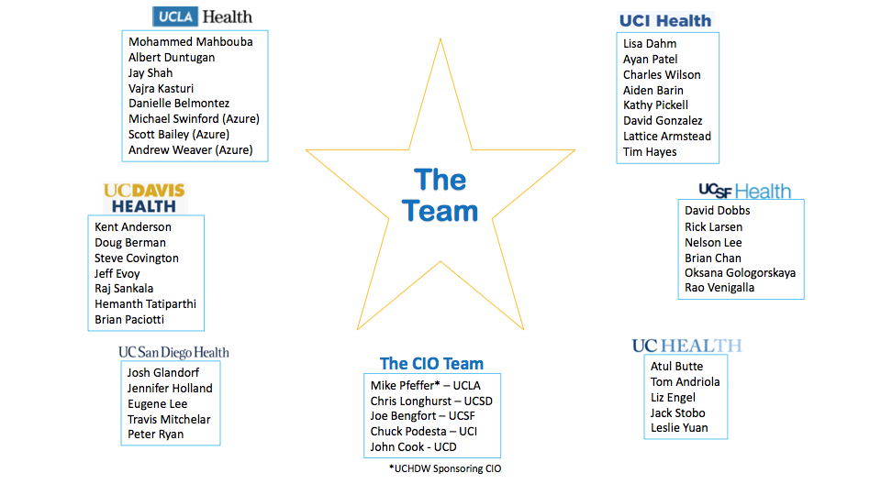

Slide 16
UCHDW: Where We Are Now
Combined EHR data from UCSF, UCLA, UC Irvine, UC Davis,
UC San Diego, and UC Riverside refreshed monthly
Uses Observational Medical Outcomes Partnership (OMOP) Common Data Model
  From 2012 to current
  4.8 million patients
  Claims data from our self-funded plans
Secure access to dashboards & analytics for CEO-approved Population Health & Quality Improvement projects
Notes:
UCHDW DDR = legally de-identified OMOP, employed techniques similar to those used by UCLA to create their DDR
Initial Collaborative Groups
Self Funded Plans
Population Health and ACO leaders
Pharmacy Chiefs
UC Cancer Consortium
Clinical Research and BRAID
Leveraging Scale for Value: Supply Chain
CEOs, strategy, and incentives
CQOs and Quality Consortium
Legal and Risk Management

Slide 17






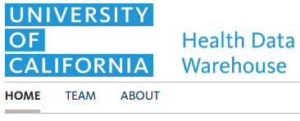




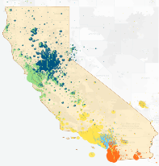

UCHDW: Current State
VPN
VPN
VPN
UCHDW
Tableau Desktop
Microsoft Azure
VPN
Azure Infrastructure as a Service (IaaS)
VPN
HomePage Server
Future
MySQL Server
(Shibboleth Log)
VPN
Tableau Server
Notes:
Phase 1 went Live Nov 2018
Established secure network connections from UC Health sites to UCHDW Analytics Cloud (powered by UCLA)
Provided UC Health Executive Leadership access to dashboards
Used Shibboleth (already in use at all UCs) for user authentication
Implemented secure connectivity from each site to UCHDW cloud
Created UCHDW Website as entry point
Dashboards are examples of how the data can be used
Access to dashboards seeds operational partnerships
Operational partners required to create actionable dashboards

Slide 18
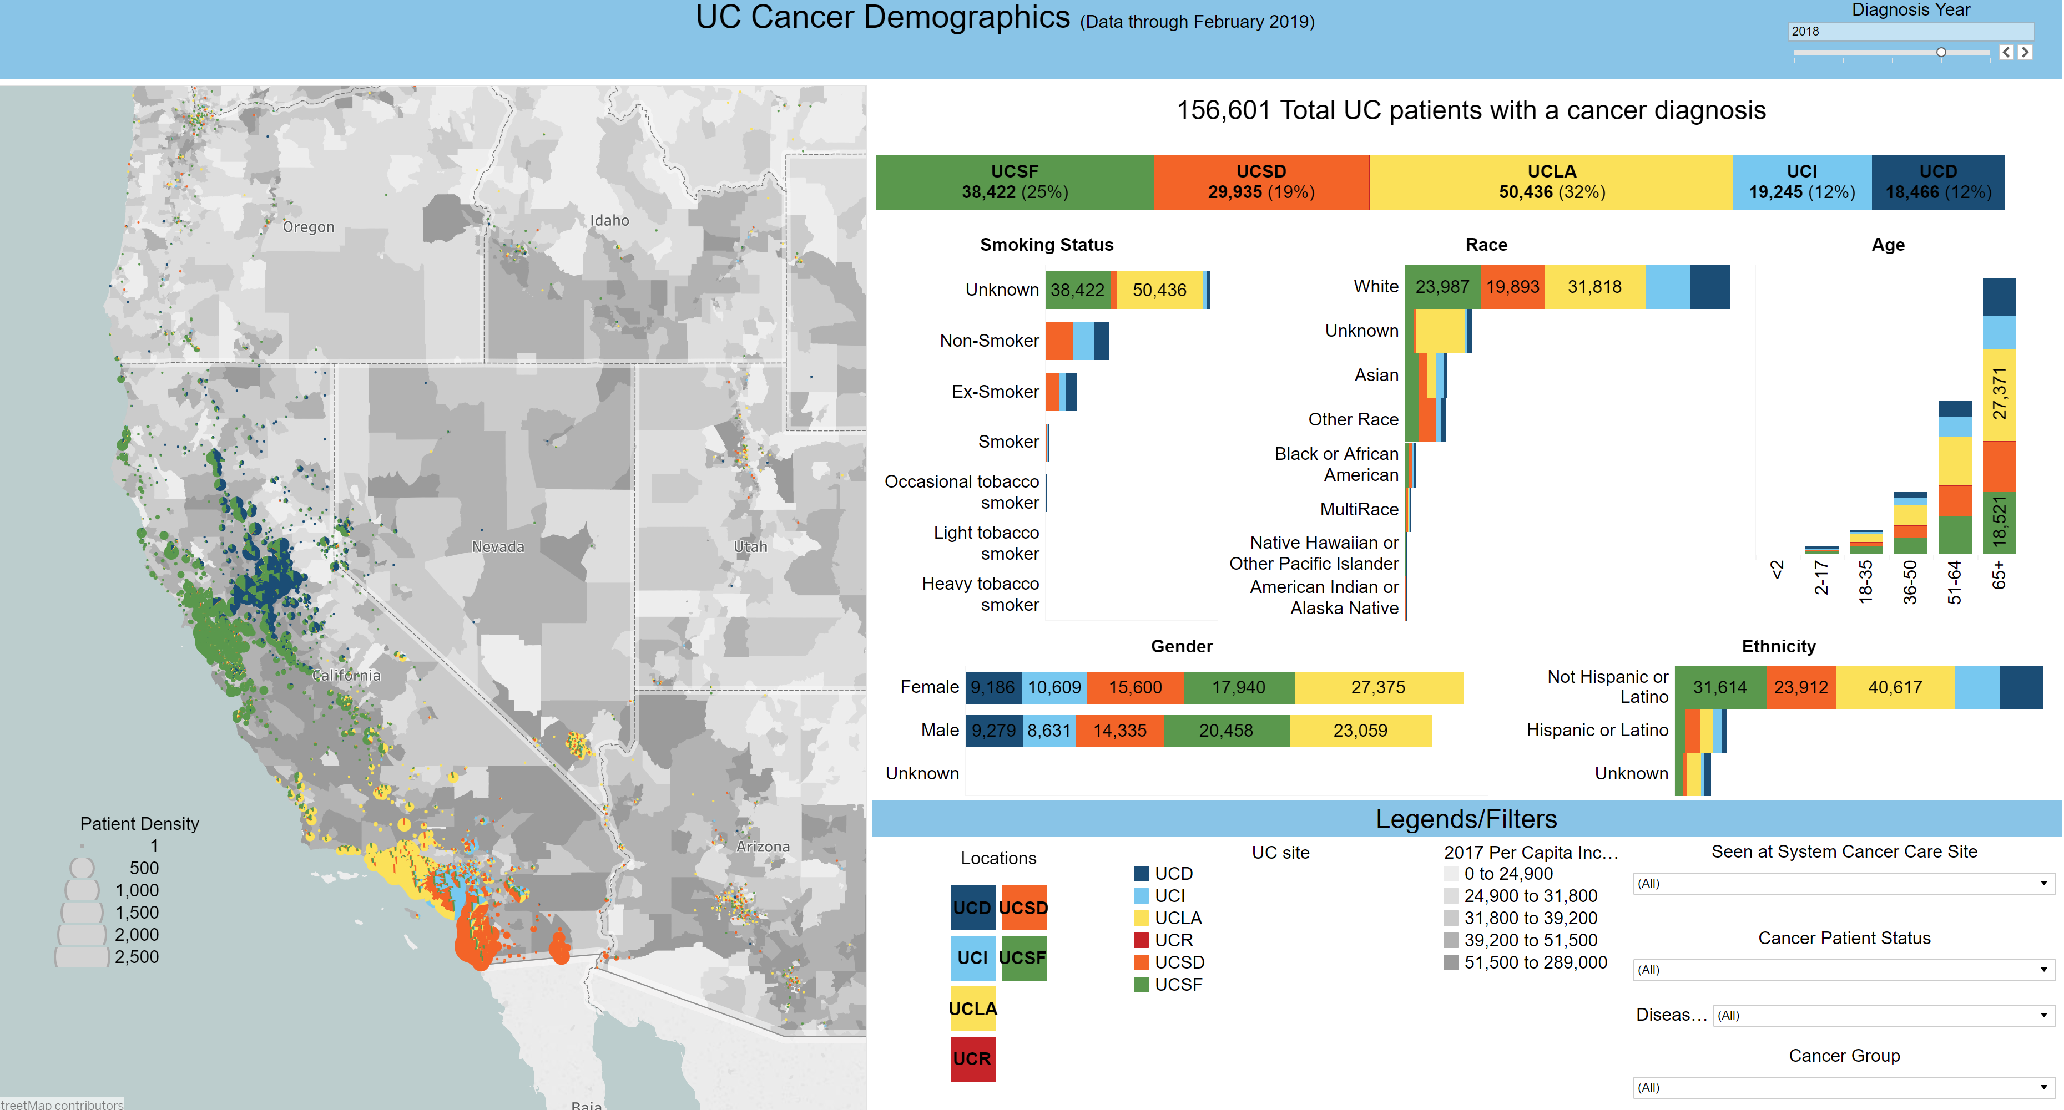
UCHDW: Current State

Slide 19
UCHDW: Where We Are Going
Enabling safe, respectful, regulated research use of clinical data
Clinical Data Browser
Virtual Desktop
  Researchers should first write and optimize OMOP SQL queries locally, on their own campuses
  When ready to scale (and authorized), UCHDW provides access to a virtual desktop for the researcher, populated with common tools
    Electronically sign a UC Health data use agreement
    R, Excel, Jupyter Notebooks, SQL
    Upload your scripts and run, but cannot download data
Predictive Analytics/Machine Learning
Notes:
Clinical Data Browser = Tableau dashboards using UCHDW DDR as data source

Slide 20
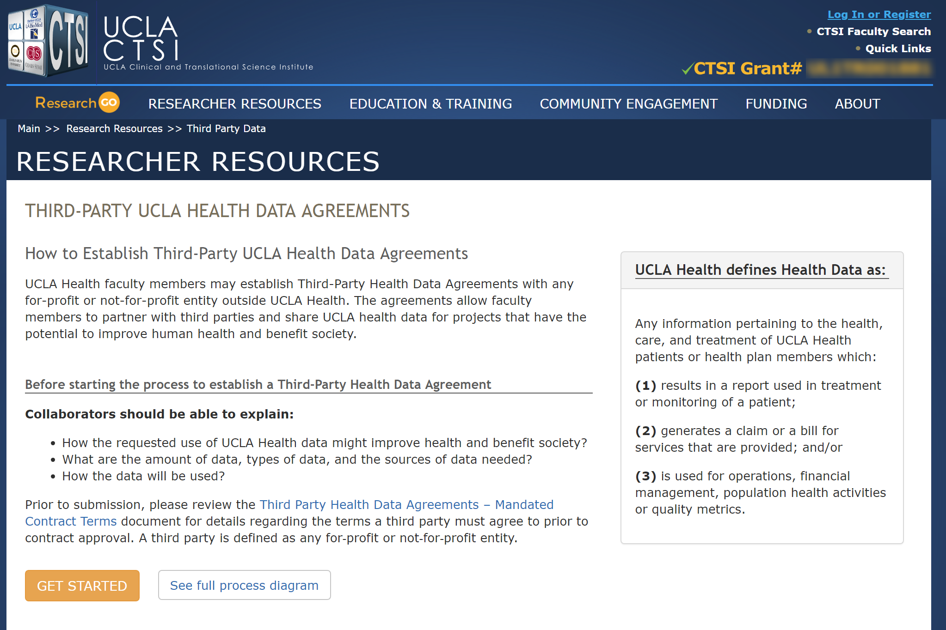
Using Health Data with Third Parties
Ensure Health Data results in a tangible outcome that directly or indirectly benefits UCLA Health’s own patients and society
  Data cannot be “sold” to third parties
  Ensure appropriate value is derived from the data
New Health Data Oversight Committee (HDOC)
  Quickly review partnerships

Slide 21
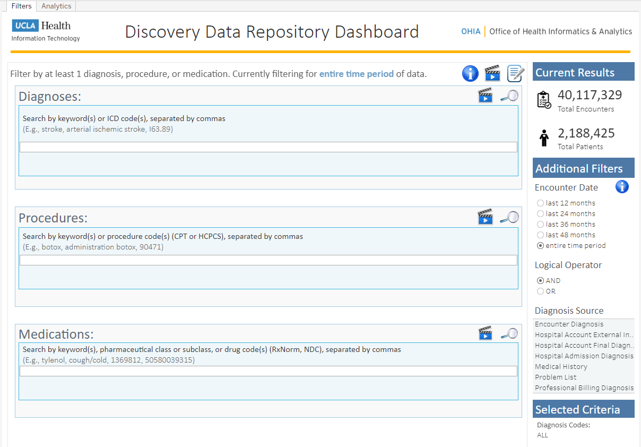
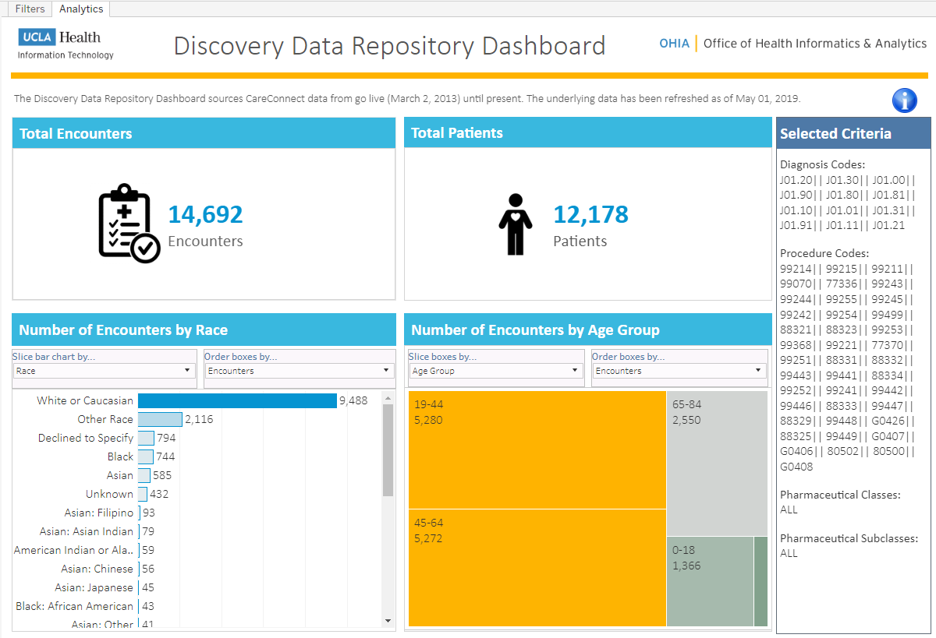
LAUNCH DATE TODAY
UCLA Health’s Discovery Data Repository (DDR)
Provides analysts and researchers access to Epic Care Connect data for data discovery patient cohort counts.
Leverages data from the Discovery Data Mart, which is a limited data set and provides information such as patients, encounters, procedures, medications, and more.

